Slide 1
22CSL51 – IOT & CLOUD COMPUTING
REVIEW - 1
TITLE : SALINE BOTTLE MONITORING
TEAM MEMBERS :
ABINANDHANA S G - 23CSR008
ABINAYA SRI J - 23CSR010
AISHVARRYA P R - 23CSR015
AKILA K - 23CSR016

Slide 2
During recent years, due to the technological advancements many sophisticated techniques has been evolved for assuring fast recovery of the patients in hospitals. Need for good patient care in hospitals, assessment and management of fluid and electrolyte is the most fundamental thing required. All most in all hospital, an assist/nurse is responsible for monitoring the electrolytes bottle level. But unfortunately, most of the time, the observer may forget to change the bottle at correct time due to their busy schedule. To overcome this critical situation, a IoT based automatic alerting and indicating device is proposed where sensor is used as a level sensor or weight sensor. It is based on the principle that the sensor output changes when fluid level/weight is below certain limit. When Fluid level/weight is low, will alerts the observer through the display or/and mobile phone at the control room indicates the room number of the patient for quick recovery.
PROBLEM STATEMENT
Saline Bottle Monitoring System

Slide 3
Proposed Solution
IoT-Based Smart Monitoring System A smart system using weight or level sensors is deployed to monitor IV fluid bottles in real-time.
Automatic Alert Mechanism When the fluid level drops below the predefined threshold, the system automatically sends an alert.
Accurate & Timely Response Ensures timely bottle replacement, reduces nurse workload, and improves patient safety.
Scalable for Multiple Patients Can monitor and alert for multiple beds/rooms in parallel using Arduino/ RaspberryPi and cloud connectivity.
Dual Notification Mode
Alerts sent via : Control Room Display , Mobile Notifications with patient room/bed details

Slide 4
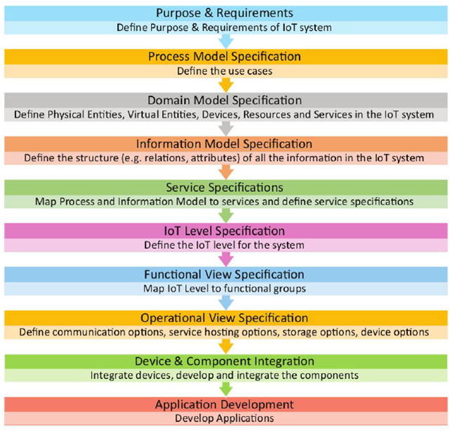
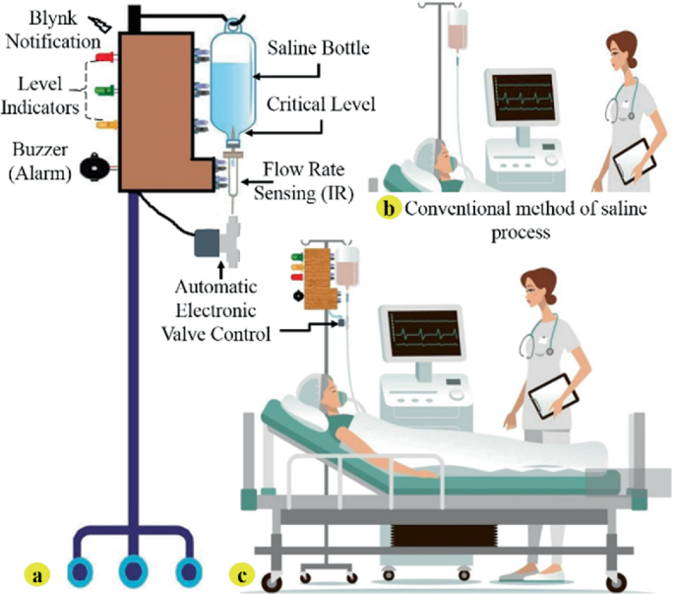
Design Methodologies
Saline Bottle Monitoring

Slide 5
Step 1: Purpose & Requirements Specification
Purpose: Design an IoT system to monitor IV fluid levels in real-time and alert nurses when fluid drops below a safe threshold, ensuring timely bottle replacement and improving patient safety.
System Behaviour:
Continuously sense IV fluid level.
Trigger alert when below threshold.
Alert includes Room/Bed ID.
Notify via control panel and mobile app.
Use buzzer/LED for urgency.
System Management:
Monitor multiple patients in real-time.
Allow alert reset after refill.
Scalable for multiple devices.
Deployment:
Devices near patient beds (Arduino)
Alerts via local display and mobile app.
Supports Wi-Fi/cloud and offline mode.
Data Analysis:
Log timestamps, Room/Bed ID, and response time.
Track nurse responsiveness for audits.

Slide 6
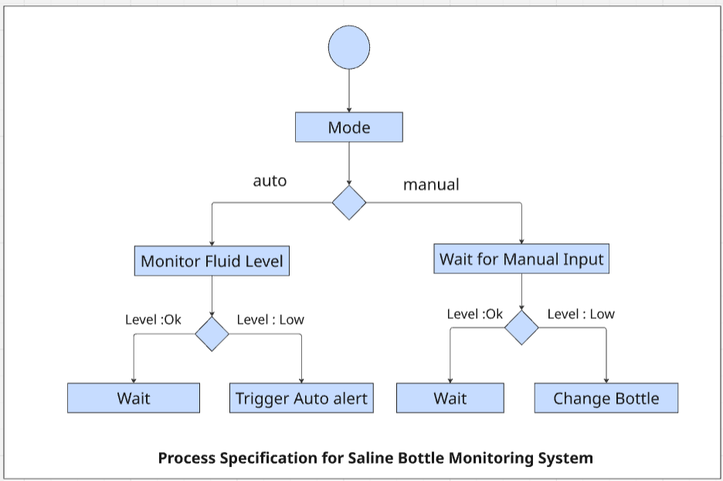
Step 2 : Process Specification (for IV Fluid Monitoring System)
Description of Modes:
The system primarily operates in a single automated mode, where:
The fluid level sensor constantly monitors the IV bottle.
If fluid level is above threshold, no action is taken.
If fluid level is below threshold, an alert is generated.
The alert includes the patient room number, and is displayed on a screen and/or sent via mobile notification.

Slide 7
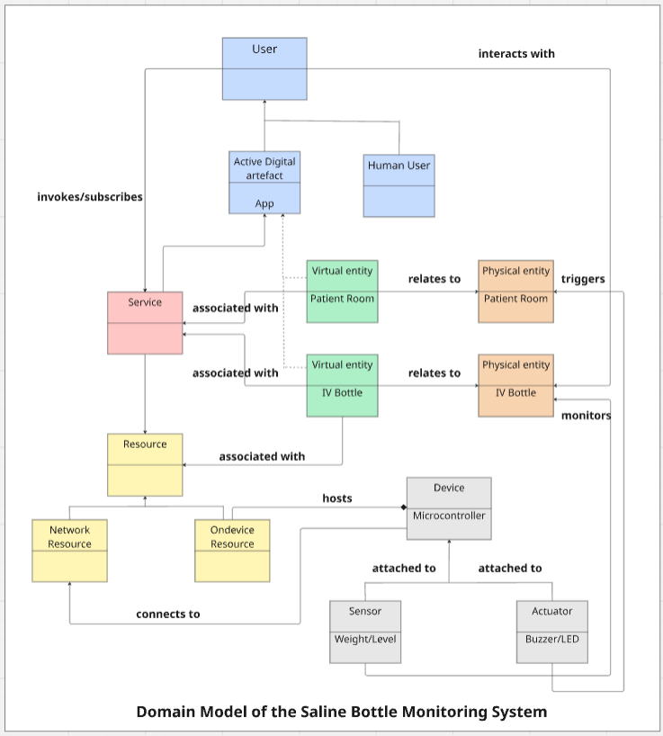
Step 3 : Domain Model Specification (for IV Fluid Monitoring System)
Physical Entities • IV Fluid Bottle – Contains medication • Patient Room – Where bottle is located
Virtual Entities • Digital IV Bottle – Shows fluid level, status • Digital Room – Room info, bed ID, alert state
Devices • ESP32/Arduino – Reads sensor data • Sensor – Ultrasonic
/Weight Sensor • (Optional) Actuator – LED/Buzzer alert
Resources • On-Device – Firmware for sensing, threshold check • Network – Cloud DB/dashboard for alerts
Services • Monitoring – Tracks fluid level • Alerting – Detects low fluid • Notification – Sends alerts to app/display

Slide 8
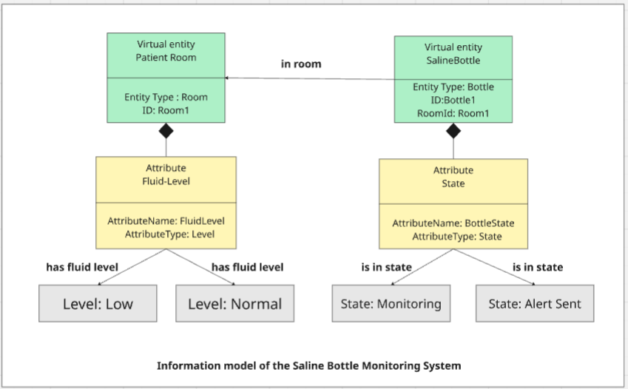
Step 4 : Information Model Specification (for IV Fluid Monitoring System)
Key Attributes
IV Fluid Bottle • Fluid Level – e.g., 45 ml • Threshold Status – Normal / Low • Alert Triggered – True / False • Last Alert Time – e.g., 2025-08-02 14:25
Patient Room • Room Number – e.g., 203 • Bed Number – e.g., B2 • Bottle Status – OK / Needs Replacement

Slide 9
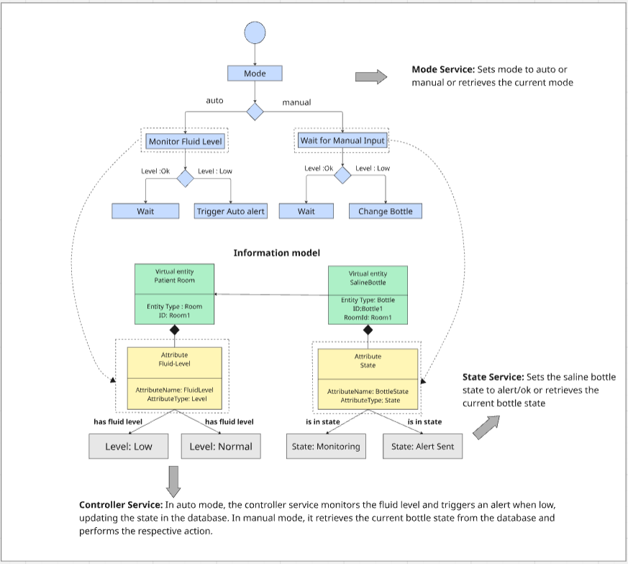
Step 5 : Service Specification
Monitoring Service
Alerting Service
Reads sensor
Compares with
threshold
Runs on microcontroller
Triggers alert on low
level
Captures timestamp
Optional: LED/buzzer
Acknowledgment Service
Notification Service
Confirms the alert has been received
Resets alert after IV bottle is replaced.
Sends alert to nurse
panel / mobile
Includes room/bed info

Slide 10
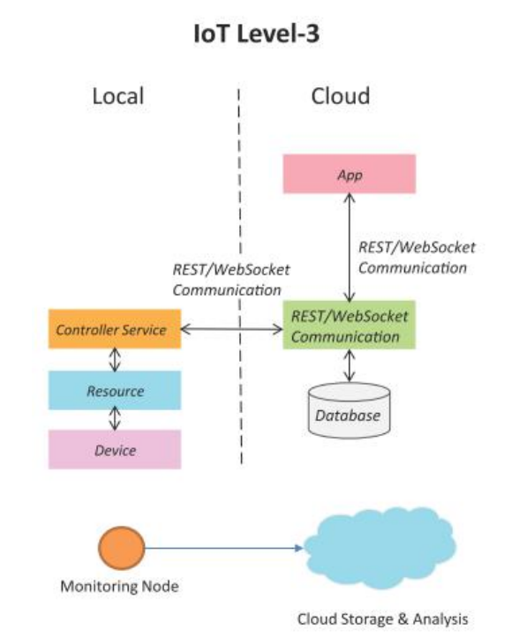
Step 6 : IOT Level Specification
Suitability of IoT Level 3 for Saline Monitoring
1. Single Node with Cloud Integration
The system monitors each IV bottle individually (single node setup).
Sends real-time data to cloud (e.g., Firebase) for centralized alerting & logging.
2. Supports Local Processing
RaspberryPi/Arduino performs on-device threshold detection.
Reduces dependency on constant internet connection for basic operations.
3. Efficient for Hospital-Scale Deployment
Level 3 allows cloud-based data storage and visualization.
Easily scalable across multiple rooms using identical single-node setups.

Slide 11
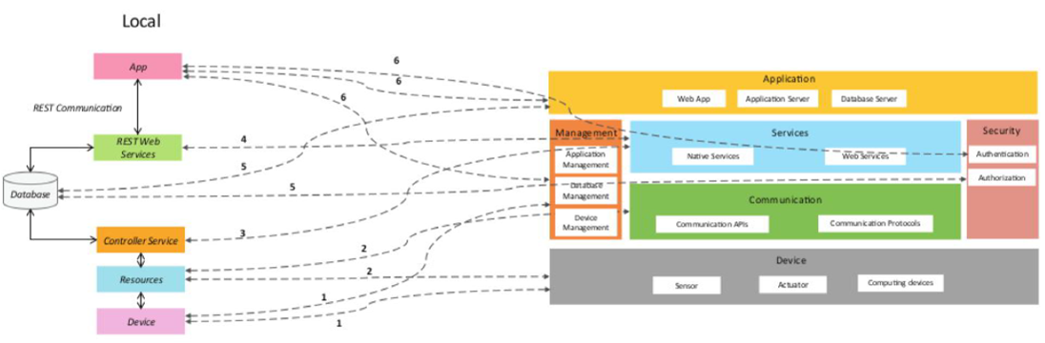
Step 7 : Functional View Specification

Slide 12
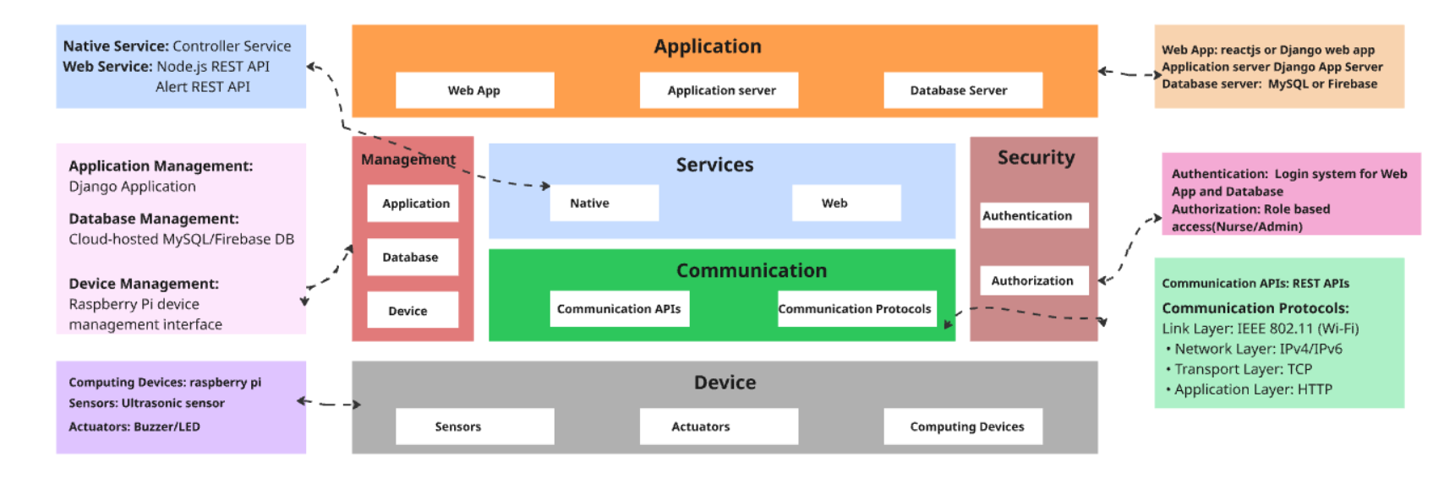
Step 8 : Operational View Specification

Slide 13
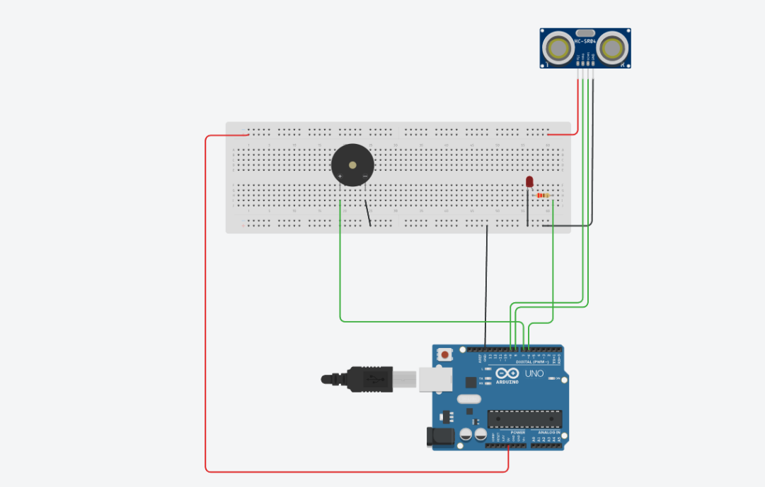
Step 9 : Device and Component Integration

Slide 14
Step 10 : Application Development
Objective: Develop the user interface and backend logic to control and monitor the IoT system.
Dashboard Design:
Auto Mode: Enables automatic alerting based on sensor threshold.
Manual Mode: Allows staff to manually check and acknowledge alerts.
IV Status Display: Shows current fluid level and alert status (Normal/Low).
Alert Controls: Toggle alerts ON/OFF or reset after bottle replacement.
Outcome: An interactive interface enabling staff to monitor IV fluid levels, switch between auto/manual modes, and respond to alerts instantly.

Slide 15
Tinkercad : https://www.tinkercad.com/things/6hm2SbZrNr3-smooth-blad/editel?returnTo=%2Fthings%2F6hm2SbZrNr3-smooth-blad&sharecode=8g16mHYRfIkP-tx1auAt8Go7bD6EtBMt8gaKmaGfTn0
Github: https://github.com/Abinandhanasg/iot-project.git

Slide 16

THANK YOU

